Slide 1
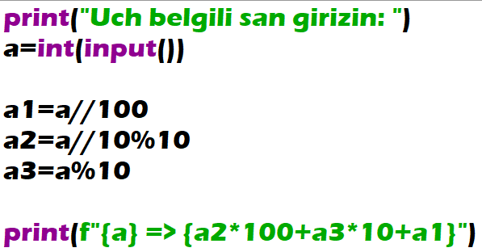
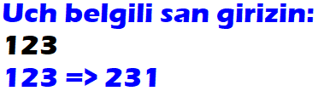
A three-digit integer is given. Output an integer obtained from the given one by moving its left digit to the right side (for example, 123 will be changed to 231).

Slide 2
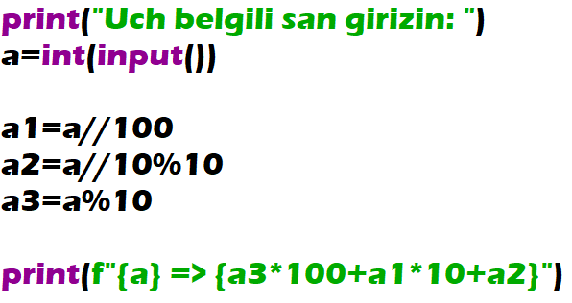
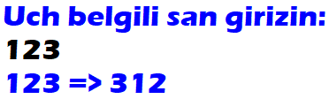
A three-digit integer is given. Output an integer obtained from the given one by moving its right digit to the left side(for example, 123 will be changed to 321).

Slide 3
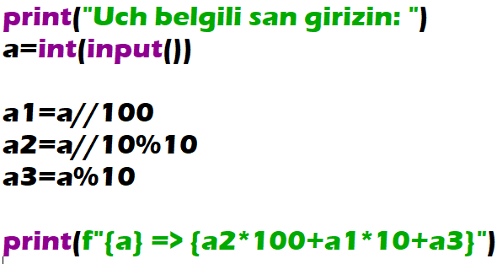
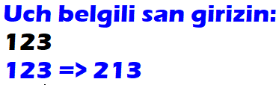
A three-digit integer is given. Output an integer obtained from the given one by exchange a tens digit and a hundreds digit (for example, 123 will be changed to 213).

Slide 4

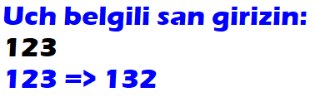
A three-digit integer is given. Output an integer obtained from the given one by exchange a ones digit and a tens digit (for example, 123 will be changed to 132).

Slide 5
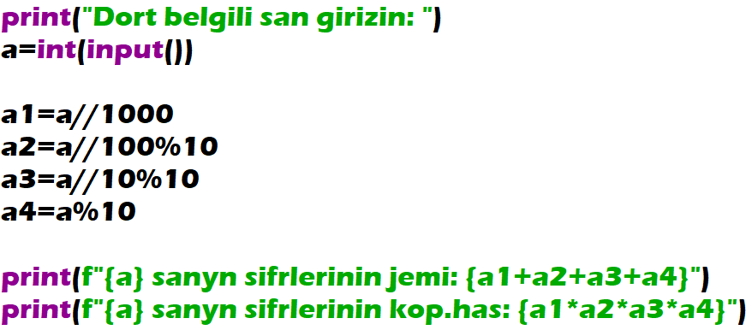
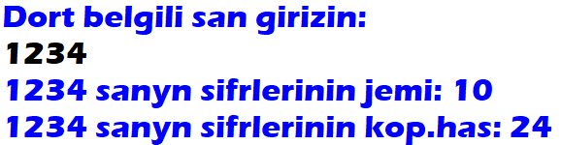
A four-digit integer is given. Find the sum and the product of its digits.

Slide 6
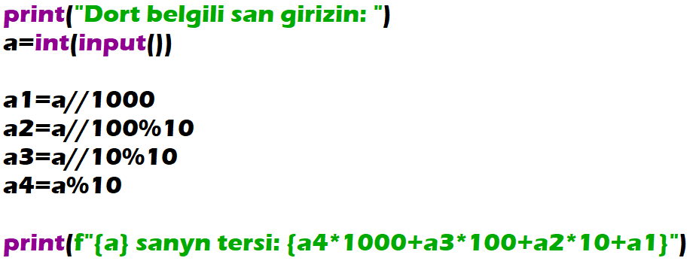
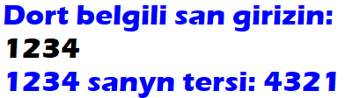
A four-digit integer is given. Output an integer obtained from the given one by reading it from right to left.

